Slide 1
Mehran S. Fallah May 2020
Discrete Mathematics
Session IX
An Introduction to Logic

Slide 2







Recapitulation
Every logic is indeed a language and consists of a syntax defining well-formed sequences of symbols, called formulas of the logic, and semantics that gives meaning to formulas.
The set of all well-formed formulas (wff) of the propositional logic (statements or propositions) is defined to be the smallest set that is closed under the following rules.
$⊤$, $⊥$, and all sentence symbols are well-formed formulas.
If $α$ and $β$ are well-formed formulas, then so are $(¬α)$, $(α∧β)$, $(α∨β)$, and $\left(α⟶β\right).$
Given a truth assignment $v:𝒜⟶\{0,1\}$, we define a valuation function $v^{∗}:𝒮⟶\{0,1\}$ that assigns a (correct) truth value to each well-formed formula $α∈𝒮$ of the language.
For all $a∈𝒜$ and $α, β∈𝒮$,
$$v^{∗}\left(a\right)=v\left(a\right).$$
$$v^{∗}\left(\left(¬α\right)\right)=1−v^{∗}\left(α\right).$$
$$v^{∗}\left(⊥\right)=0.$$
$$v^{∗}\left(α∧β\right)=v^{∗}\left(α\right)v^{∗}\left(β\right).$$
$$v^{∗}\left(⊤\right)=1.$$
$$v^{∗}\left(α∨β\right)=v^{∗}\left(α\right){+ v}^{∗}\left(β\right)−v^{∗}\left(α\right)v^{∗}\left(β\right).$$
$$v^{∗}\left(α⟶β\right)={1−v}^{∗}\left(α\right)\left(1−v^{∗}\left(β\right)\right).$$

Slide 3
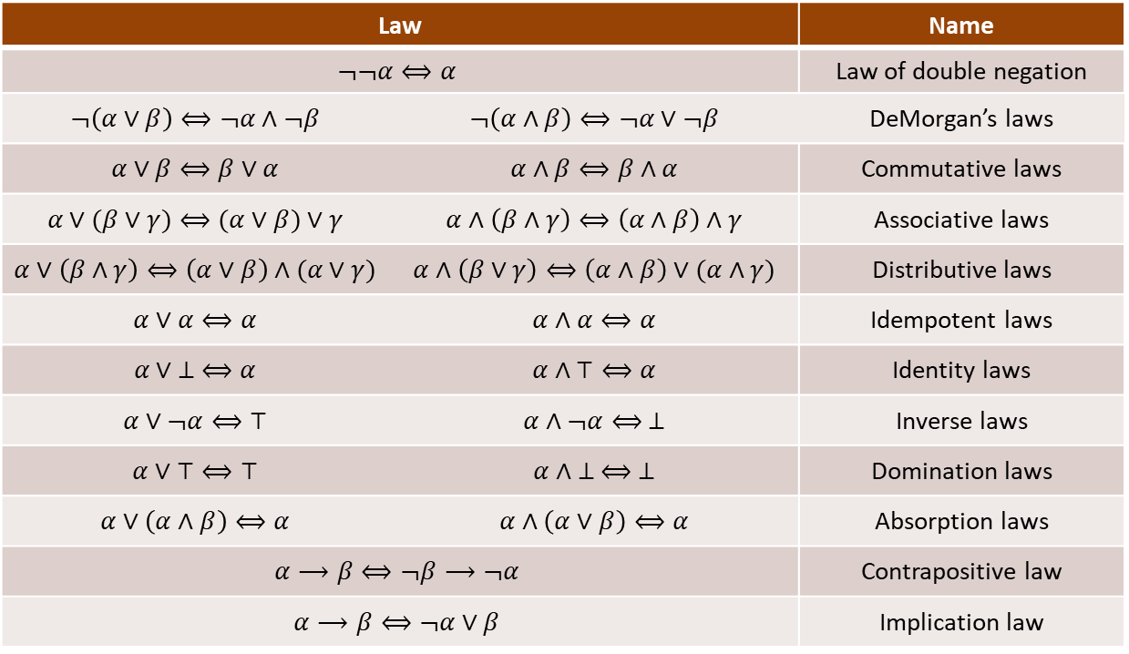

Recapitulation (Ctd.)
A formula $α$ of the propositional logic is said to be a valid formula, or a tautology, if it is always true, that is, $v^{∗}\left(α\right)=1$ for all truth assignments $v$. A formula $α$ is called a contradiction if $v^{∗}\left(α\right)=0$ for all truth assignments $v$.
Two formulas $α$ and $β$ of the propositional logic are said to be logically equivalent, denoted $α⟺β$, if $α⟷β$ is a valid formula, i.e., a tautology. Equivalently, two statements $α$ and $β$ are logically equivalent if and only if $v^{∗}\left(α\right)=v^{∗}\left(β\right)$ for every truth assignment $v$.
The following table lists important laws for the algebra of propositions.

Slide 4
Introduction
This session is concerned with the logical inference.
The rules of logical inference indeed reflect what the deductive thought, of human, is based upon (at least partially.)
For example, if the two sentences “It is cold in Mumbai now.” and “It rains whenever it is cold in Mumbai.” are true, one can deduce (infer) that “It rains in Mumbai now.” Similarly, from “If I study hard, I pass the course.” and “If I pass the course, I can get a job.”, it is deduced that “If I study hard, I can get a job.”
We shall study the rationale behind such deductions. We will also be able to determine which logical arguments, represented in the form of propositional logic formulas, are valid arguments and which are not.
In fact, we give rules of inference and show that how one can employ them to prove the validity of a given argument.
It is also shown that how one may find a counterexample to the invalidity of an argument.
The concept of logical inference is also closely related to the concepts theorem and proof.

Slide 5










Logical Implication
Definition 1. For two formulas $α$ and $β$, we say that $α$ logically implies $β$ and write $α⟹β$ if $α⟶β$ is a valid formula, i.e., a tautology.
What does a logical implication tell us?
Let $α⟹β$ be a logical implication. This means that in every possible model $v$, that is, in any state of affairs, $α⟶β$ is true. Alternatively, if $α$ is true in a model, then so is $β$ in that model. The formula $β$ cannot be false in a model in which $α$ is true.
The logical implication $\left(α_{1}∧α_{2}∧…∧α_{n}\right)⟹β$ can be interpreted as follows: if $α_{1}$, $α_{2}$, …, $α_{n}$ are all true, then $β$ is true. In fact, the conclusion $β$ logically follows from the premises $α_{1}$, $α_{2}$, …, $α_{n}$.
Example 1. Show that $\left(\left(p⟶r\right)∧\left(¬q⟶p\right)∧¬r\right)⟹q$.
Solution.
You may also show that $v^{∗}\left(\left(\left(p⟶r\right)∧\left(¬q⟶p\right)∧¬r\right)⟶q\right)=1$ or make use of the truth table for $\left(\left(p⟶r\right)∧\left(¬q⟶p\right)∧¬r\right)⟶q$.
We also say that the truth of the conclusion $q$is deduced or inferred from the truth of the premises $p⟶r$, $¬q⟶p$, and $¬r$.
$$\left(\left(p⟶r\right)∧\left(¬q⟶p\right)∧¬r\right)⟶q$$
$$⟺¬\left(\left(¬p∨r\right)∧\left(q∨p\right)∧¬r\right)∨q$$
$$⟺\left(\left(p∧¬r\right)∨\left(¬q∧¬p\right)∨r\right)∨q$$
$$⟺\left(\left(p∨r\right)∧\left(¬r∨r\right)\right)∨\left(\left(¬q∨q\right)∧\left(¬p∨q\right)\right)$$
$$⟺\left(\left(p∨r\right)∧⊤\right)∨\left(⊤∧\left(¬p∨q\right)\right)$$
$$⟺\left(p∨r\right)∨\left(¬p∨q\right)$$
$$⟺\left(p∨¬p\right)∨\left(r∨q\right)$$
$$⟺⊤∨\left(r∨q\right)$$
$$⟺⊤$$

Slide 6




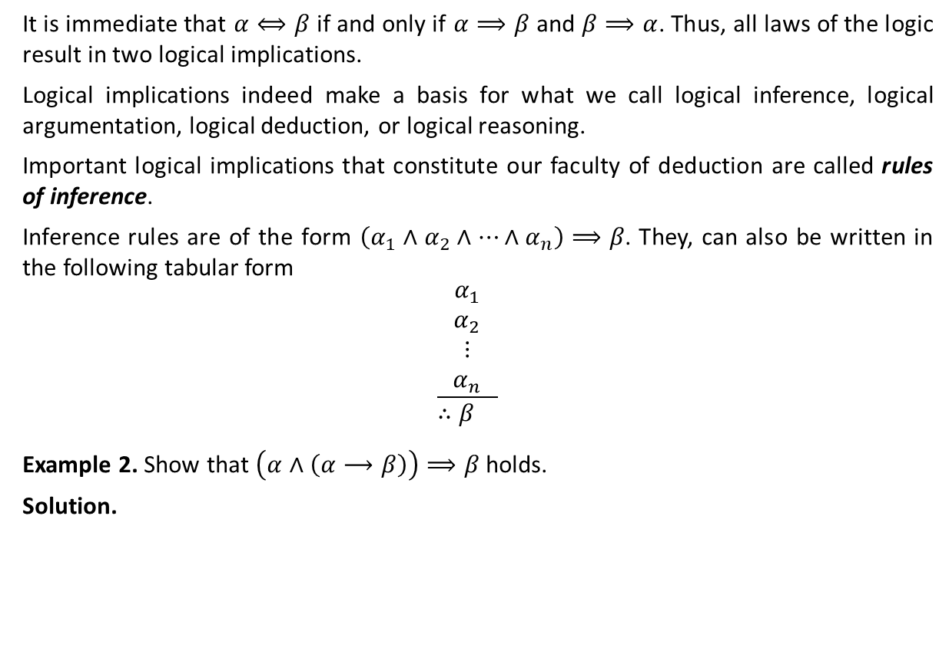




Logical Implication (Ctd.)
It is immediate that $α⟺β$ if and only if $α⟹β$ and $β⟹α$. Thus, all laws of the logic result in two logical implications.
Logical implications indeed make a basis for what we call logical inference, logical argumentation, logical deduction, or logical reasoning.
Important logical implications that constitute our faculty of deduction are called rules of inference.
Inference rules are of the form $\left(α_{1}∧α_{2}∧…∧α_{n}\right)⟹β$. They, can also be written in the following tabular form
$$\frac{\begin{matrix}α_{1} \\ α_{2} \\ \begin{aligned}⋮ \\ α_{n}\end{aligned}\end{matrix}}{∴β }$$
Example 2. Show that $\left(α∧\left(α⟶β\right)\right)⟹β$ holds.
Solution.
$$\left(α∧\left(α⟶β\right)\right)⟶β⟺\left(¬α∨¬\left(α⟶β\right)\right)∨β$$
$$⟺\left(¬α∨\left(α∧¬β\right)\right) ∨β$$
$$⟺¬α∨\left(\left(α∧¬β\right)∨β\right)$$
$$⟺¬α∨\left(\left(α∨β)∧(¬β∨β\right)\right)$$
$$⟺¬α∨(\left(α∨β\right)∧⊤)$$
$$⟺¬α∨\left(α∨β\right)$$
$$⟺\left(¬α∨α\right)∨β$$
$$⟺⊤∨β$$
$$⟺⊤$$

Slide 7






Logical Implication (Ctd.)
The logical implication $\left(α∧\left(α⟶β\right)\right)⟹β$ is (perhaps) the most important inference rule, called Modus Ponens or the Rule of Detachment. In tabular form, it is written
The following is a valid argument:
Alice wins a ten-million-dollar lottery.
If Alice wins a ten-million-dollar lottery, then Bob will quit his job.
Therefore, Bob will quit his job.
The following are two other important rules of inference.
$$\frac{\begin{matrix} α \\ α⟶β \end{matrix}}{∴β }$$
Logical Implication | Tabular Form | Name
$\left(\left(α⟶β\right)∧¬β\right)⟹¬α$
$$\frac{\begin{matrix}α⟶β \\ ¬β \end{matrix}}{∴¬α }$$
Modus Tollens
$$\frac{\begin{matrix}α⟶β \\ β⟶γ \end{matrix}}{∴α⟶γ }$$
$\left(\left(α⟶β\right)∧(β⟶γ\right)⟹(α⟶γ)$
Law of the Syllogism

Slide 8
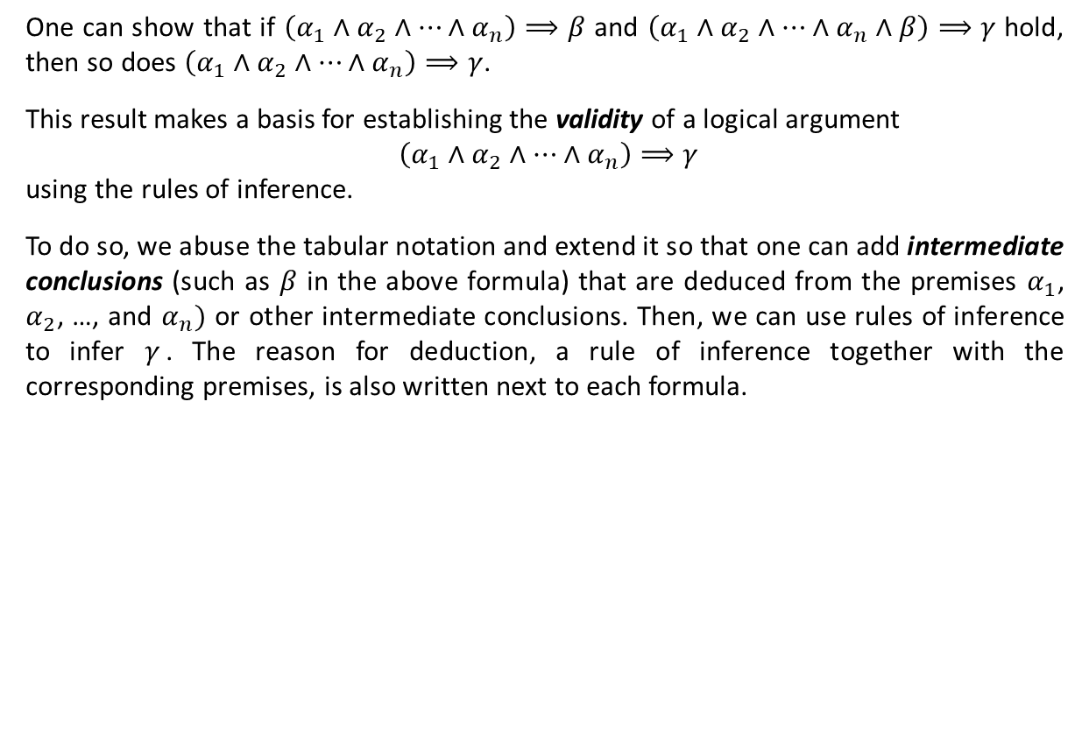

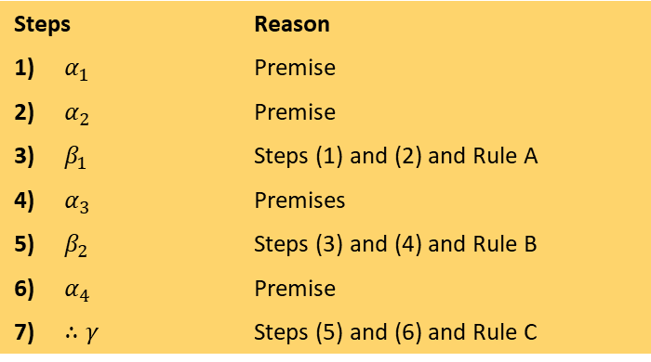
Validity of Logical Arguments
One can show that if $\left(α_{1}∧α_{2}∧…∧α_{n}\right)⟹β$ and $\left(α_{1}∧α_{2}∧…∧α_{n}∧β\right)⟹γ$ hold, then so does $\left(α_{1}∧α_{2}∧…∧α_{n}\right)⟹γ$.
This result makes a basis for establishing the validity of a logical argument
$\left(α_{1}∧α_{2}∧…∧α_{n}\right)⟹γ$
using the rules of inference.
To do so, we abuse the tabular notation and extend it so that one can add intermediate conclusions (such as $β$ in the above formula) that are deduced from the premises $α_{1}$, $α_{2}$, …, and $α_{n})$ or other intermediate conclusions. Then, we can use rules of inference to infer $γ$. The reason for deduction, a rule of inference together with the corresponding premises, is also written next to each formula.
Steps |  | Reason
1) | $$α_{1}$$ | Premise
2) | $$α_{2}$$ | Premise
3) | $$β_{1}$$ | Steps (1) and (2) and Rule A
4) | $$α_{3}$$ | Premises
5) | $$β_{2}$$ | Steps (3) and (4) and Rule B
6) | $$α_{4}$$ | Premise
7) | $$∴γ$$ | Steps (5) and (6) and Rule C
Establishing the validity of the argument
$$\begin{matrix}{ α}_{1} \\ { α}_{2} \\ \begin{aligned} { α}_{3} \\ \frac{ α_{4}}{∴γ}\end{aligned}\end{matrix}$$

Slide 9
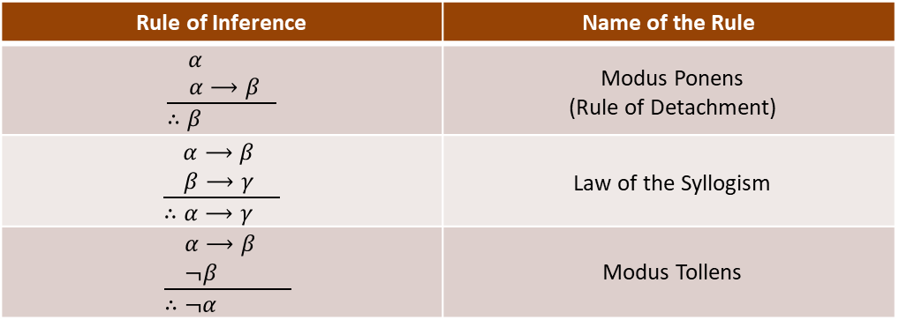













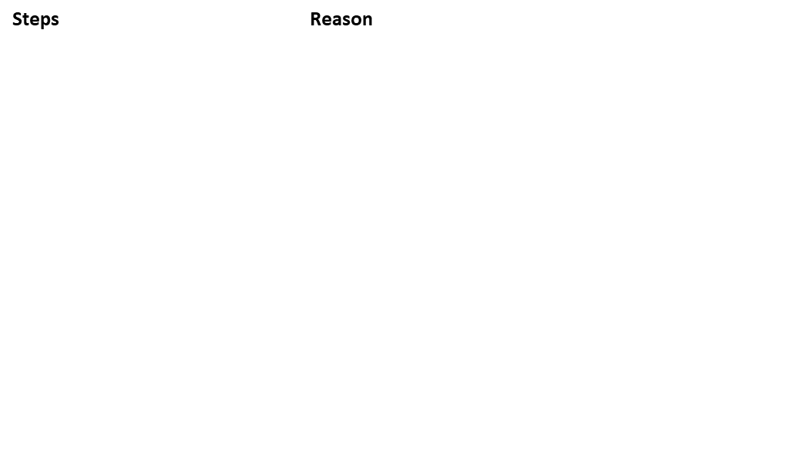





Validity of Logical Arguments (Ctd.)
Example 3. Prove the validity of the following argument.
Solution.
$$p⟶r$$
$$r⟶s$$
$$t∨¬s$$
$$¬t∨u$$
$$¬u$$
$$∴¬p$$
Steps |  | Reason
1)
$$p⟶r$$
Premise
2)
Premise
$$r⟶s$$
3)
$$p⟶s$$
Steps (1) and (2) and the Law of the Syllogism
4)
$$t∨¬s$$
Premise
5)
$$¬s∨t$$
Step (4) and the Commutative Law of $∨$
6)
$$s⟶t$$
Step (5) and the Law of Implication ($α⟶β⟺¬α∨β$)
7)
$$p⟶t$$
Steps (3) and (6) and the Law of the Syllogism
8)
$$¬t∨u$$
Premise
9)
$$t⟶u$$
Step (8) and the Law of Implication ($α⟶β⟺¬α∨β$)
10)
$$p⟶u$$
Steps (7) and (9) and the Law of the Syllogism
11)
$$¬u$$
Premise
12)
$$∴¬p$$
Steps (10) and (11) and Modus Tollens

Slide 10







A List of Inference Rules
The following is a list of inference rules.
Rule of Inference | Name of the Rule
$$\frac{\begin{matrix} α \\ α⟶β \end{matrix}}{∴β }$$
Modus Ponens
(Rule of Detachment)
$$\frac{\begin{matrix}α⟶β \\ β⟶γ \end{matrix}}{∴α⟶γ }$$
Law of the Syllogism
$$\frac{\begin{matrix}α⟶β \\ ¬β \end{matrix}}{∴¬α }$$
Modus Tollens
$$\frac{\begin{matrix} \\ \begin{aligned}α \\ β \end{aligned}\end{matrix}}{∴α∧β }$$
Rule of Conjunction
$$\frac{α∧β}{∴α }$$
Rule of Conjunctive Simplification
$$\frac{α }{∴α∨β}$$
Rule of Disjunctive Amplification
$$\frac{\begin{matrix}α⟶γ \\ β⟶γ \end{matrix}}{∴\left(α∨β\right)⟶γ}$$
Rule for Proof by Cases

Slide 11
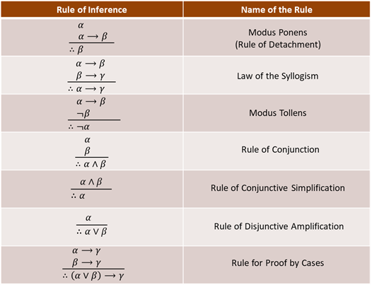


















Application of Inference Rules
$$p⟶q$$
Example 4. Show that is a valid argument.
Solution.
$$q⟶(r∧s)$$
$$¬r∨(¬t∨u)$$
$$p∧t$$
$$∴u$$
Steps |  | Reason
1)
$$p⟶q$$
Premise
2)
$$q⟶(r∧s)$$
Premise
3)
$$p⟶(r∧s)$$
Steps (1) and (2) and the Law of the Syllogism
4)
$$p∧t$$
Premise
5)
$$p$$
Step (4) and the Rule of Conjunctive Simplification
6)
$$r∧s$$
Steps (3) and (5) and Modus Ponens
7)
$$r$$
Step (6) and the Rule of Conjunctive Simplification
8)
$$¬r∨(¬t∨u)$$
Premise
9)
$$¬\left(r∧t\right)∨u$$
Step (8), the Associative Law of $∨$, and DeMorgan’s Laws
10)
$$t$$
Step (4) and the Rule of Conjunctive Simplification
11)
$$r∧t$$
Steps (7) and (10) and the Rule of Conjunction
12)
$$(r∧t)⟶u$$
Step (8) and the Law of Implication ($α⟶β⟺¬α∨β$)
13)
$$∴u$$
Steps (11) and (12) and Modus Ponens

Slide 12
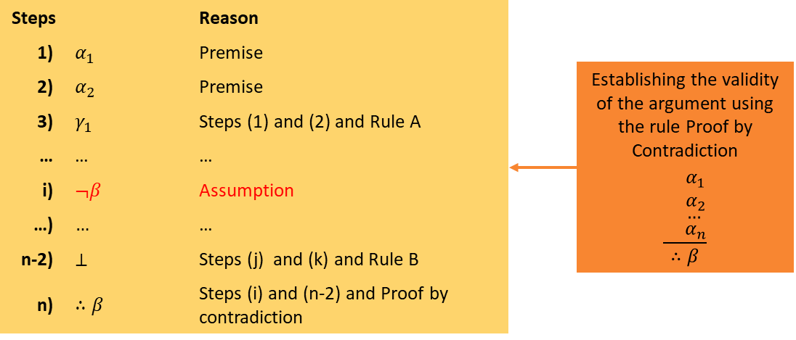
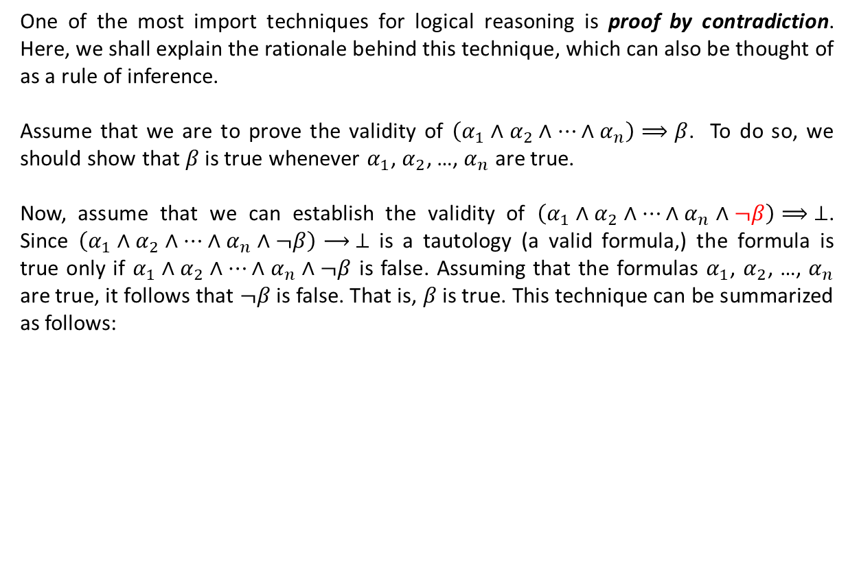
Proof by Contradiction
One of the most import techniques for logical reasoning is proof by contradiction. Here, we shall explain the rationale behind this technique, which can also be thought of as a rule of inference.
Assume that we are to prove the validity of $\left(α_{1}∧α_{2}∧…∧α_{n}\right)⟹β$. To do so, we should show that $β$ is true whenever $α_{1}$, $α_{2}$, …, $α_{n}$ are true.
Now, assume that we can establish the validity of $\left(α_{1}∧α_{2}∧…∧α_{n}∧¬β\right)⟹ ⊥$. Since $\left(α_{1}∧α_{2}∧…∧α_{n}∧¬β\right)⟶ ⊥$ is a tautology (a valid formula,) the formula is true only if $α_{1}∧α_{2}∧…∧α_{n}∧¬β$ is false. Assuming that the formulas $α_{1}$, $α_{2}$, …, $α_{n}$ are true, it follows that $¬β$ is false. That is, $β$ is true. This technique can be summarized as follows:
(Premise)

Slide 13
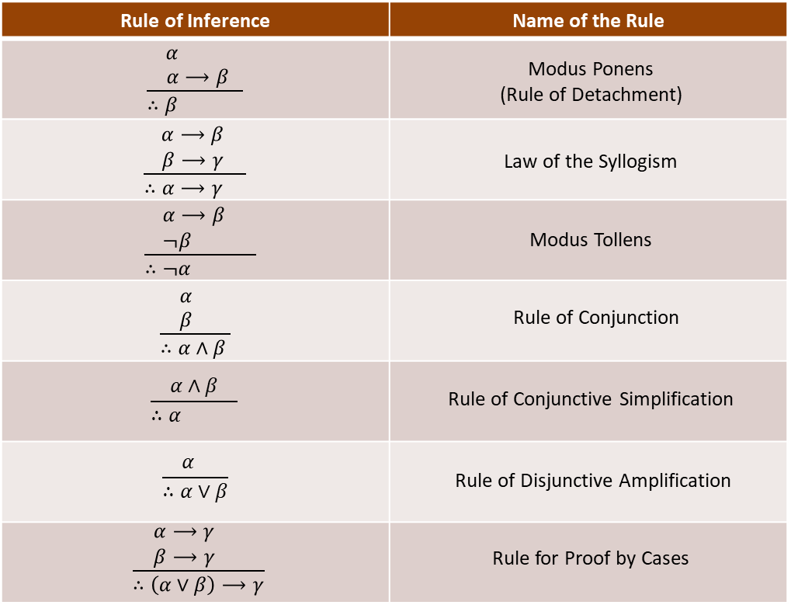
















Proof by Contradiction (ctd.)
Example 5. Show that is a valid argument.
Solution.
$$¬p⟷q$$
$$q⟶r$$
$$¬r$$
$$∴p$$
Steps |  | Reason
1)
$$¬p⟷q$$
Premise
2)
$$\left(¬p⟶q\right)∧(q⟶¬p)$$
Step (1) and $α⟷β⟺\left(α⟶β\right)∧(β⟶α)$
3)
$$¬p⟶q$$
Step (1) and the Rule of Conjunctive Simplification
4)
$$q⟶r$$
Premise
5)
$$¬p⟶r$$
Steps (3) and (4) and the Law of the Syllogism
Assumption charged
6)
$$¬p$$
Assumption (Premise)
7)
$$r$$
Steps (5) and (6) and Modus Ponens
8)
$$¬r$$
Premise
9)
$$r∧¬r$$
Steps (7) and (8) and the Rule of Conjunction
10)
$$⊥$$
Step (9) and $α∧¬α⟺ ⊥$
Assumption discharged
11)
$$∴p$$
Steps (6) and (10) and Proof by Contradiction

Slide 14


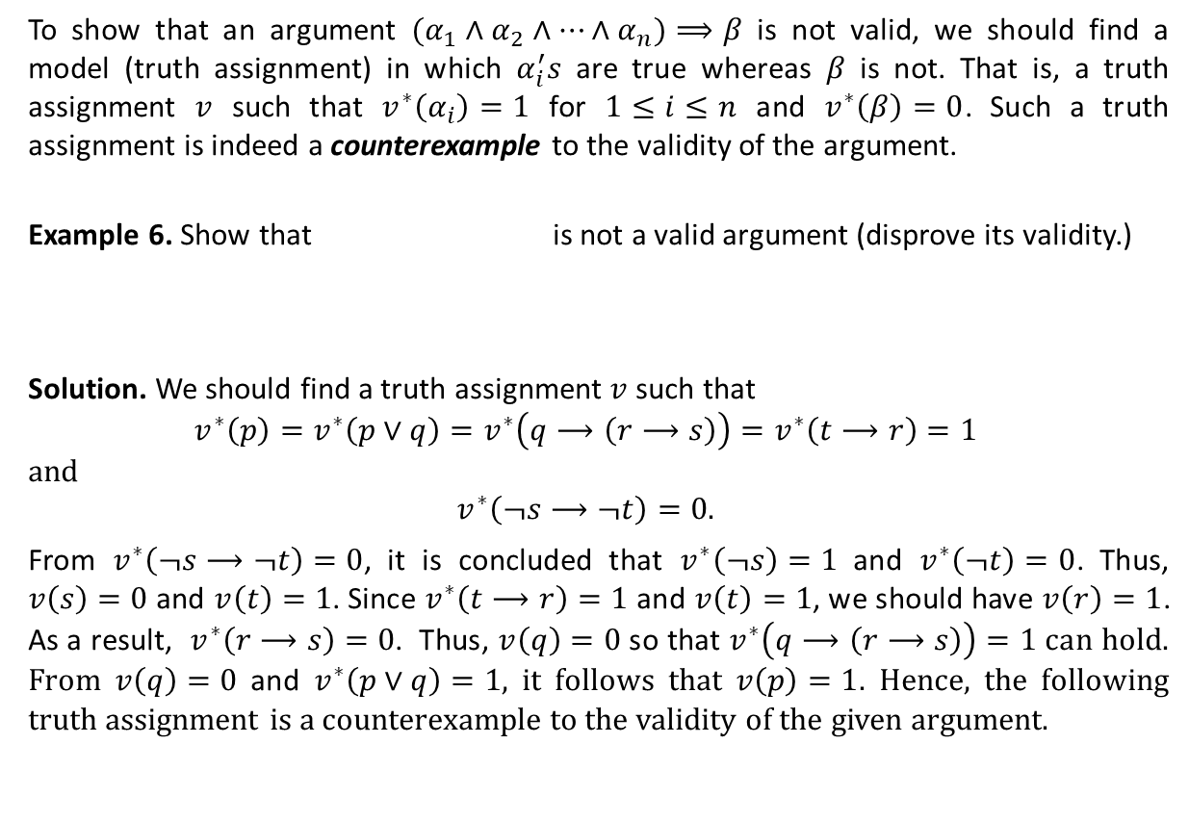



Invalid Arguments
To show that an argument $(α_{1}∧α_{2}∧…∧α_{n})⟹β$ is not valid, we should find a model (truth assignment) in which $α_{i}^{′}s$ are true whereas $β$ is not. That is, a truth assignment $v$ such that $v^{∗}\left(α_{i}\right)=1$ for $1≤i≤n$ and $v^{∗}\left(β\right)=0$. Such a truth assignment is indeed a counterexample to the validity of the argument.
Example 6. Show that is not a valid argument (disprove its validity.)
Solution. We should find a truth assignment $v$ such that
$$v^{∗}\left(p\right)=v^{∗}\left(p∨q\right)=v^{∗}\left(q⟶\left(r⟶s\right)\right)=v^{∗}\left(t⟶r\right)=1$$
and
$$v^{∗}\left(¬s⟶¬t\right)=0.$$
From $v^{∗}\left(¬s⟶¬t\right)=0$, it is concluded that $v^{∗}\left(¬s\right)=1$ and $v^{∗}\left(¬t\right)=0$. Thus, $v\left(s\right)=0$ and $v\left(t\right)=1$. Since $v^{∗}\left(t⟶r\right)=1$ and $v\left(t\right)=1$, we should have $v\left(r\right)=1$. As a result, $v^{∗}\left(r⟶s\right)=0$. Thus, $v\left(q\right)=0$ so that $v^{∗}\left(q⟶\left(r⟶s\right)\right)=1$ can hold. From $v\left(q\right)=0$ and $v^{∗}\left(p∨q\right)=1$, it follows that $v\left(p\right)=1$. Hence, the following truth assignment is a counterexample to the validity of the given argument.
$$p$$
$$p∨q$$
$$q⟶(r⟶s)$$
$$t⟶r$$
$$∴¬s⟶¬t$$
$$v\left(p\right)=v\left(r\right)=v\left(t\right)=1, v\left(q\right)=v\left(s\right)=0$$

Slide 15


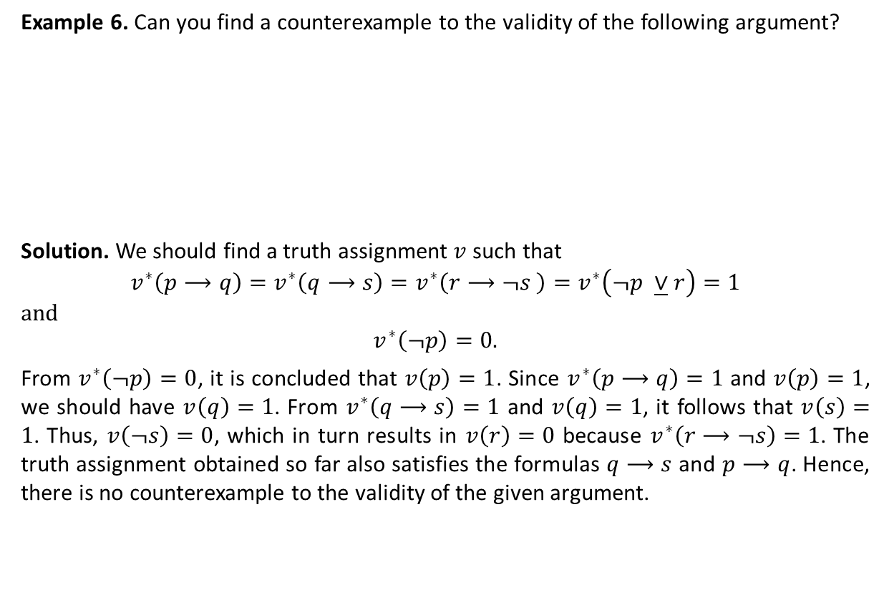



Invalid Arguments (ctd.)
Example 6. Can you find a counterexample to the validity of the following argument?
Solution. We should find a truth assignment $v$ such that
$$v^{∗}\left(p⟶q\right)=v^{∗}\left(q⟶s\right)=v^{∗}\left(r⟶¬s \right)=v^{∗}\left(¬p \underline{∨}r\right)=1$$
and
$$v^{∗}\left(¬p\right)=0.$$
From $v^{∗}\left(¬p\right)=0$, it is concluded that $v\left(p\right)=1$. Since $v^{∗}\left(p⟶q\right)=1$ and $v\left(p\right)=1$, we should have $v\left(q\right)=1$. From $v^{∗}\left(q⟶s\right)=1$ and $v\left(q\right)=1$, it follows that $v\left(s\right)=1$. Thus, $v\left(¬s\right)=0$, which in turn results in $v\left(r\right)=0$ because $v^{∗}\left(r⟶¬s\right)=1$. The truth assignment obtained so far also satisfies the formulas $q⟶s$ and $p⟶q$. Hence, there is no counterexample to the validity of the given argument.
$$p⟶q$$
$$q⟶s$$
$$r⟶¬s$$
$$¬p\underline{∨}r$$
$$∴¬p$$

Slide 16
Textbook: Ralph P. Grimaldi, Discrete and Combinatorial Mathematics
You may begin doing exercises of Chapter 2.

